Slide 1






Slide 2


ABOUT COMPANY
For many years, FenixHydrotech LLC has operated under the FenixHydrotech brand, delivering consulting, design, equipment supply, and maintenance services in the fields of cooling towers, as well as water and wastewater treatment systems.
Established in 2014, FenixHydrotech LLC operates as a franchise of an international company with nearly 1,700 employees worldwide. In Azerbaijan, we have successfully implemented long-term EPC projects, primarily in the oil and gas sector.
Leveraging a strong technical foundation, a highly specialized engineering team, and extensive industry experience, we offer innovative water technology solutions for both industrial and domestic applications — staying true to our motto: “Innovation in Water Technologies.”

Slide 3





















Our International and Local References

Slide 4
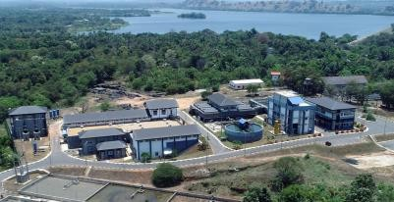
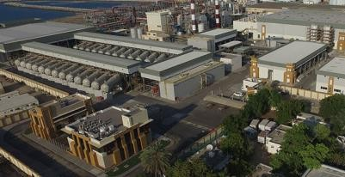
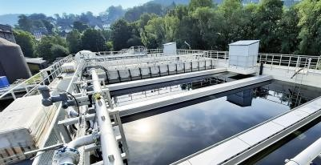
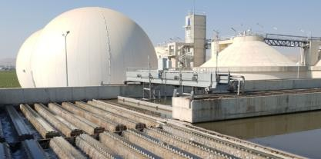
ENGINEERING DIVISION
Along with sales and post sales services Engineering cover industrial level water solutions for real needs of any manufacturing facility.
Drinking Water
Treatment
Wastewater Treatment
Sludge
Treatment
Desalination

Slide 5

Our Capabilities
With extensive experience in executing turnkey projects both domestically and internationally, we are equipped with a highly qualified professional team and, where required, specialized subcontractors to deliver all aspects of project implementation.
 | Fields of Activity | Supply and Production
 |  | Design | System Production | Chemical supply | Technical Services
1 | Drinking water | ● | ● | ● | ●
2 | Process water | ● | ● | ● | ●
3 | Wastewater | ● | ● | ● | ●
4 | Oil-contaminated areas | ● | ● | ● | ●

Slide 6

Our Capabilities
Consulting
Preparations
Meetings
Evaluation
Calculations
Drafting ToR
Installation
Assembling
Montage
Start-up
Reporting
Production
Manufacturing
Delivering
Quality Control
Testing
Maintenance
Regular control
Emergency response
Stockkeeping
Supply
Equipment
Accessories
Spare parts
Chemicals
Manpower
Project Design
Development
Scopes/timelines
Documentation
Information flow
Reporting system

Slide 7
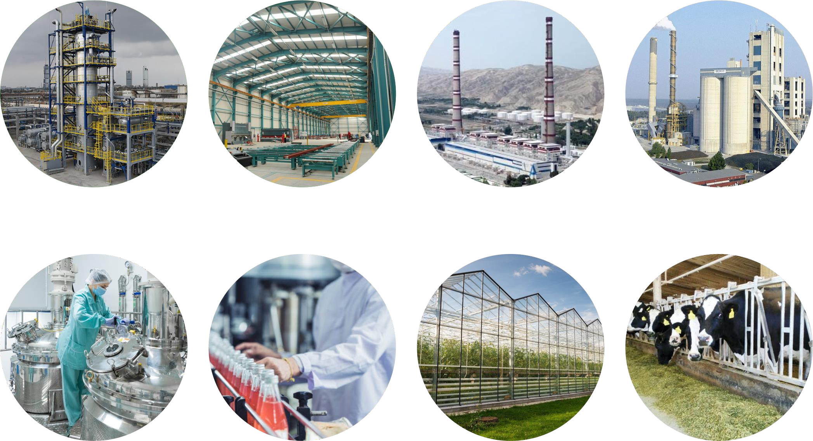
KEY MARKETS
Oil & gas production
Metal
processing
Energy
production
Constriction materials
manufacturing
Pharmaceutical products manufacturing
Food and beverage
processing
Plant cultivation
Animal husbandry
and poultry

Slide 8

PROJECT IMPLEMENTATION
Basic Engineering
Detailed Engineering
Procurement and Manufacturing
Civil Construction
Installation and Commissioning
Maintenance

Slide 9
Ünvan: Əhməd Rəcəbli 28/3b, Bakı, Azərbaycan
Mobil Tel: +994 (55) 701 39 72
Email: sales@fenixhydrotech.com
Web: www.fenixhydrotech.com

